Slide 1

Digital Marketing Strategy

Slide 2
Digital marketing strategy
Metrics
Metrics are important in defining what successful value-exchange is worth to an organisation and how this worth will be measured.
This step needs to be considered in conjunction with value-exchange.
Digital is an empirical medium and digital marketing should start with ROI in mind.

Slide 3
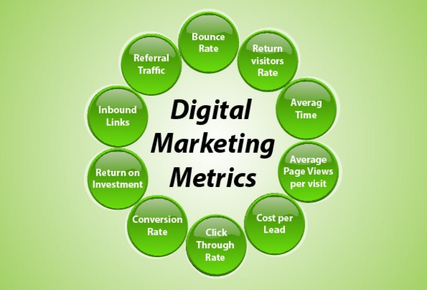
Digital marketing strategy
Metrics

Slide 4
Digital marketing strategy
Ongoing Optimization:
The growing necessity for an organization to remain dynamic and agile ties in with metrics and should be considered in the early stages of strategy formulation, as well as being a continuous process in refining and optimizing tactics.
The user experience and journey is vital to building successful brands. Budget should be set aside upfront to be dedicated to the analysis of user data and the optimization of conversion paths.

Slide 5
Search Engine Working

Slide 6




History of Search
1990 – Archi Query Form
FTP based file search engine
Feb 1993 – Excite.com
General word relation based search
Oct 1993 – AliWeb
Manual submission engine
Jan 1994 – Altavista
First natural language search engine

Slide 7




Jan 1996 – Backrup
Started by Larry Page and Segrey Brin
Sep 15 1997 – Google.com
First search engine with Page Rank Technology
1997 – Yandex.com
Russian based search engine
1998 – MSN Search
Microsoft Rival to Google

Slide 8




2000 – Baidu.com
Chinese based search engine
2008 – duckduckgo.com
Non tracking search engine
2009 – Bing.com
Microsoft Rival to Google
2010 – Blekko.com
Spam and Virus free search
http://www.searchenginehistory.com/ http://www.google.co.in/about/company/history/ http://www.wordstream.com/articles/internet-search-engines-history

Slide 9
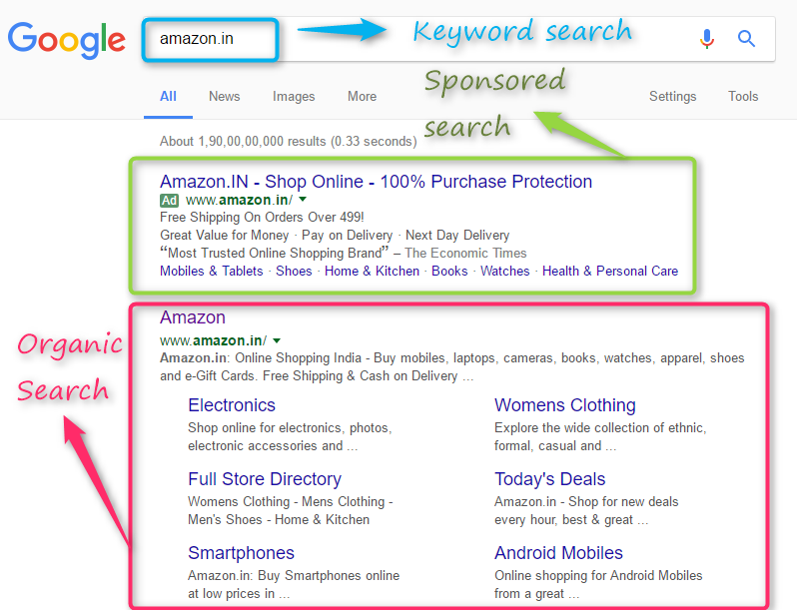
Search Engine Working
How Search Engines Work
Search engine is a software program designed to identify and respond to the specific questions, called as SERP with relevant information available on the web.
Search Query
Organic Results
Paid Result

Slide 10
Search Engine Working
Definitions
Search
COMPUTING (transitive verb) to examine a computer file, disk, database, or network for particular information
Engine
something that supplies the driving force or energy to a movement, system, or trend
Search Engine
a computer program that searches for particular keywords and returns a list of documents in which they were found, especially a commercial service that scans documents on the Internet

Slide 11
Search Engine Working
How Search Engines Work
Three basic stages;
Crawl: Content is discovered
Indexing: Content is analyzed and stored in database
Ranking & Retrieval: Rank according to the user query and displayed

Slide 12
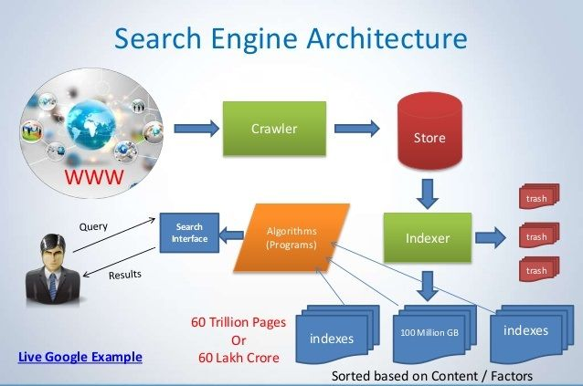
Search Engine Working
There are a number of circumstances where a URL will not be indexed by a search engine. This may be due to:
Robots.txt file exclusions – a file which tells search engines what they shouldn’t visit on your site.
Directives on the webpage telling search engines not to index that page (noindex tag) or to index another similar page (canonical tag).
Search engine algorithms judging the page to be of low quality, have thin content or contain duplicate content.
The URL returning an error page (e.g. a 404 Not Found HTTP response code).

Slide 13
Search Engine Working
Types of Search Engines
Crawlers based SE: Google and Yahoo
Hybrid: Combination of crawlers, directory results
Meta: Combines all search engines results and compile into one listing. Metacrawler, Dogpile
Directories:Human edited- Yahoo directories

Slide 14
Search Engine Working
Directories
www.dmoz.org
Website classified into a Taxonomy
Website are categorically arranged Searching vs Navigation
Instead of Query, you Click and navigate Accurate search always! (if data is available) Problem: Mostly Manually created

Slide 15
